Slide 1

Technical Proposal
The Coastal School
Study Gym

Slide 2
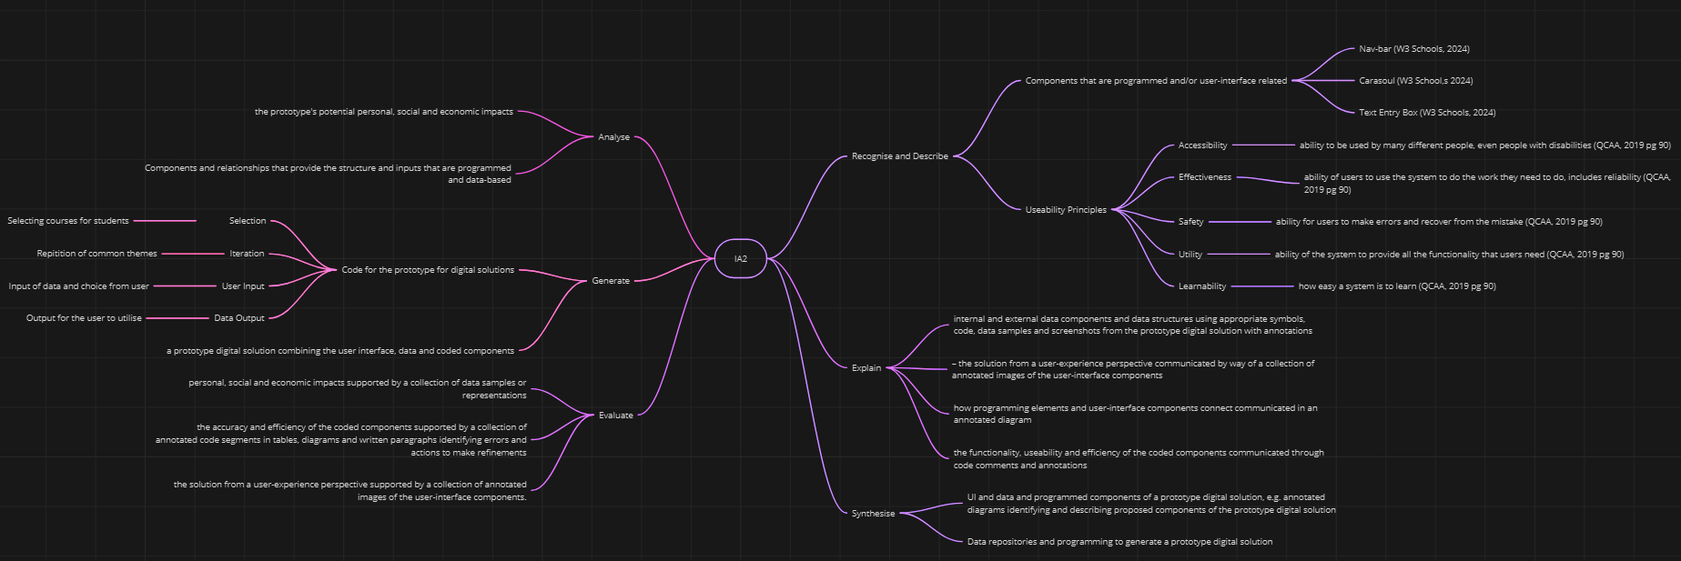
Mind Map
Constraints Prescribed & Self-Determined Criteria
- Time – The task must be complete in a 6-week timeframe
- Legal – All resources used are under CC 4.0 which allows free use of online assets, including images and datasets and all other sources are referenced according to APA 7
- Data – Data available is existing paper record
Streamline the tutoring process for students
Have a feedback system where students can write “reviews” and teachers write their advice for the student
Provide a secure platform that complies with student data privacy regulations
Co-ordinating proper use of the library space, ensuring there are zero conflicts
Provide management services for teachers to organise sessions
Provide tools that help the student better their use of time, juggling extra curriculars
Access to historical feedback data to track student’s progression.
Provide data on the resources used during sessions
Comprehensive reports for admin staff should be utilised to help the trial of this program.
An ease-of-use UI for individuals with low tech literacy.
Journal for personal growth tracking as well as reflections
Platform for feedback of all parties in the system.
Exiting Solution: Tixel.com
The existing solution to the assignment is a ticketing P2P based system that allows users to sell and buy tickets to events, such as concerts and comedy shows. It highlights a high-quality website that can be used as a framework to build the Study Gym model at The Coastal School.
Notes:
Probably don’t need the text top left. Its just taking up room and not adding anything.
If you’re using it for yourself as a prompt, just remember to remove it.

Slide 3
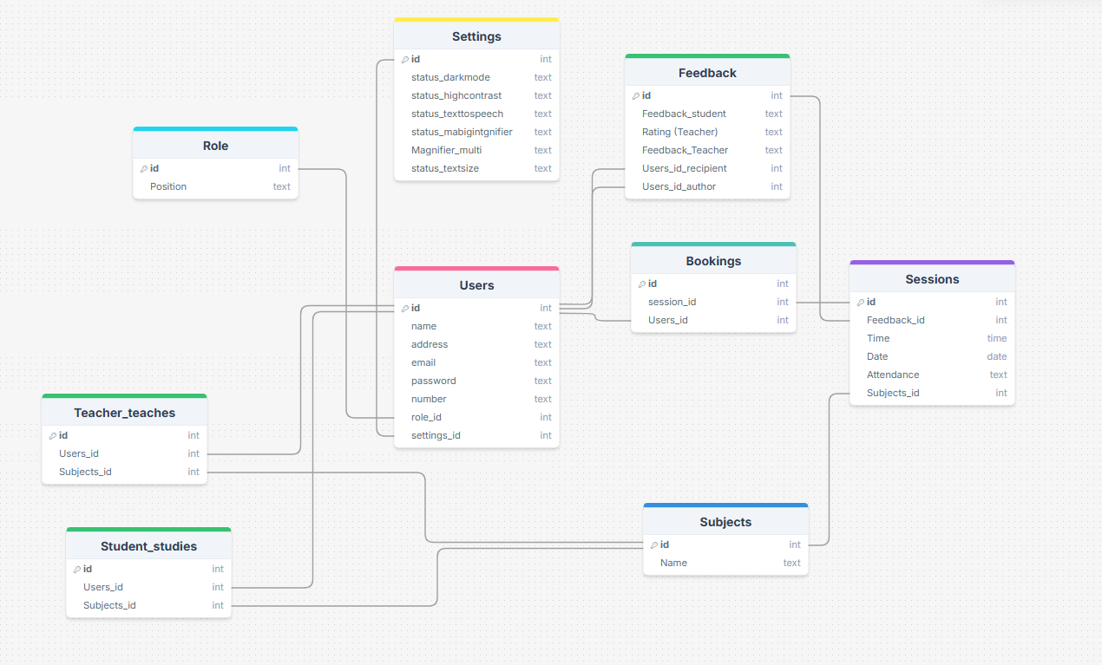
Normalisation Analysis of Schema
First Normal Form (1NF) is where the table does not contain multi-valued or composite attributes. Meaning that every column must have a unique name, each value must be of the same type and each column can only contain single values. This is shown as an example within the bookings dataset via the id, sessions_id and users_id being the only two columns.
Second Normal Form (2NF) reduces impracticality and creates consistency within a database. A database must first reach 1NF and furthermore not have any partial dependencies to reach the criteria for 2NF. Exemplified by the feedback dataset with 5 different columns that don’t contain partial dependencies.
Third Normal Form (3NF) removes of non-trivial function dependencies. Aligning with 1NF and 2NF, 3NF removes non-primary keys’ attributes transitive dependency of the primary key. Shown via the sessions dataset, as dependencies are removed and the relational diagram removes transitive dependency (Geeks for Geeks, 2025).
This database schema represents Study Gym with multiple tables. The “Users” table holds general user information like name, address email, phone number and login details. “Bookings” connect “Users” and “Sessions”, which are linked to specific “Subjects”. This is further linked to a “Teacher_teaches” and “Student_studies” table which have the user_id and subjects_id. The “Sessions” table containing the time, date and attendance of the student. The “Feedback” table captures student and teacher feedback along with ratings. As well as the settings table, containing the user’s settings statuses (being on or off), the multiplier of the magnifier and text size status. The schema covers all bases that can be expected within a management system trying to organise multiple parties together.
Notes:
With the normalization section, it would be great if you could also include an example from your ERD below.
Consider colour coding it, for example for 1NF you could then write; as seen below highlighted in RED, this does xxxx
If you have a users table with a name on it and a teacher/student ID, what is the purpose of those tabeles?

Slide 4
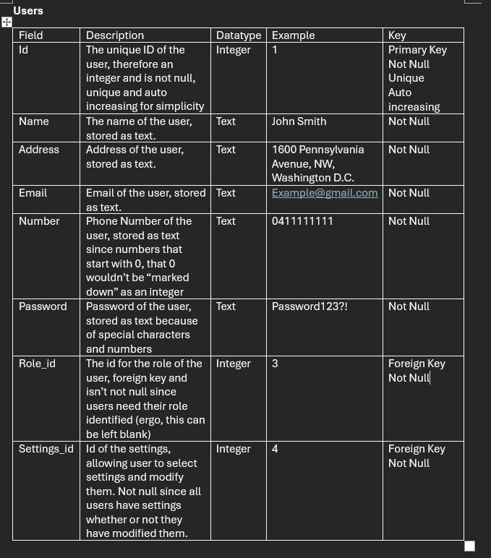
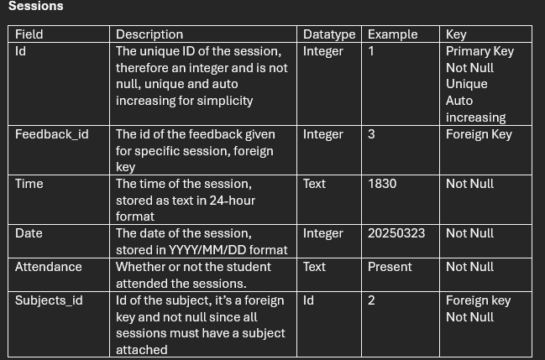
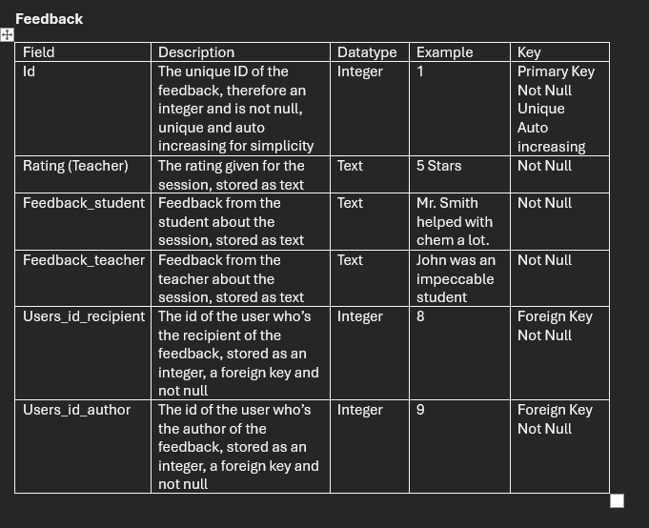
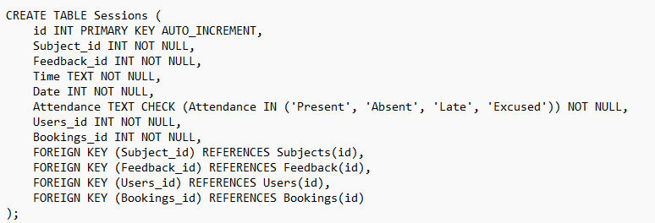
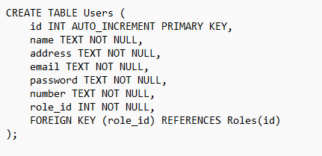
These data dictionaries provide 5 columns pertaining to each index in their respective database, being users, sessions and feedback. The field is the name of the index, such as “number” or “rating”. The description provides information as to what the index actually is, why the choice for datatype was chosen and some basic reasoning towards keys that were added. The datatype column says what datatype the index is, such as an integer, text or float. (although float isn’t used) in this instance. The example column provides an example for the given field. Such as in the address field, having an example address of the White House. Lastly, the key column provides the properties to the field, such as whether or not it’s a primary key or foreign key if the field is an id, if it has to be unique, not null or autoincreasing.
This concrete schema creates the Users and Sessions table in SQL. These define the different fields, like id, time, date, emails, passwords, foreign keys and etc. It also references the foreign keys to their respective tables. Such as Subject_id being referred to the subjects table and their id field. The concrete schema also lists the datatype and keys of each field. Like whether it’s an integer or text and also if it’s not-null or auto incrementing.
Notes:
These are great.

Slide 5
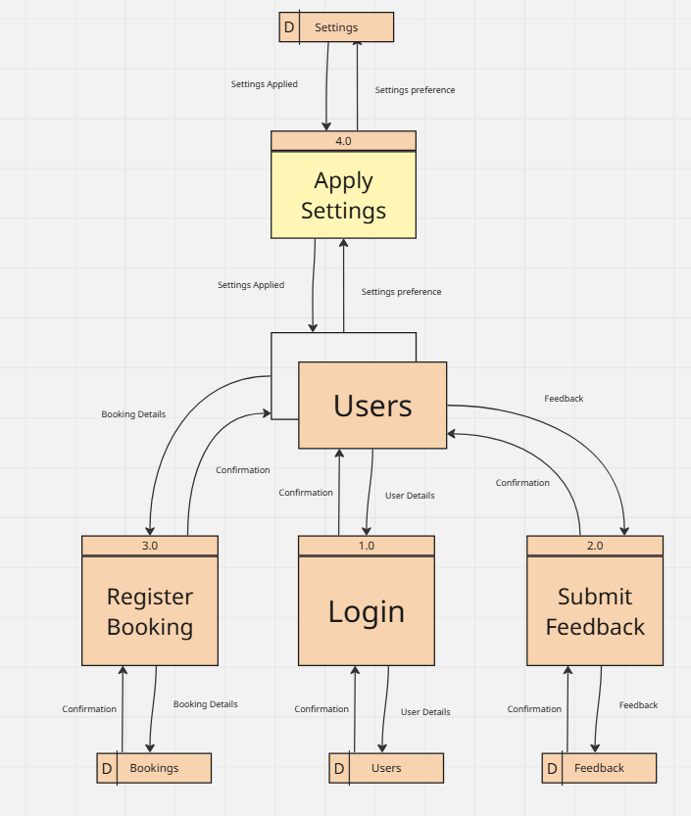
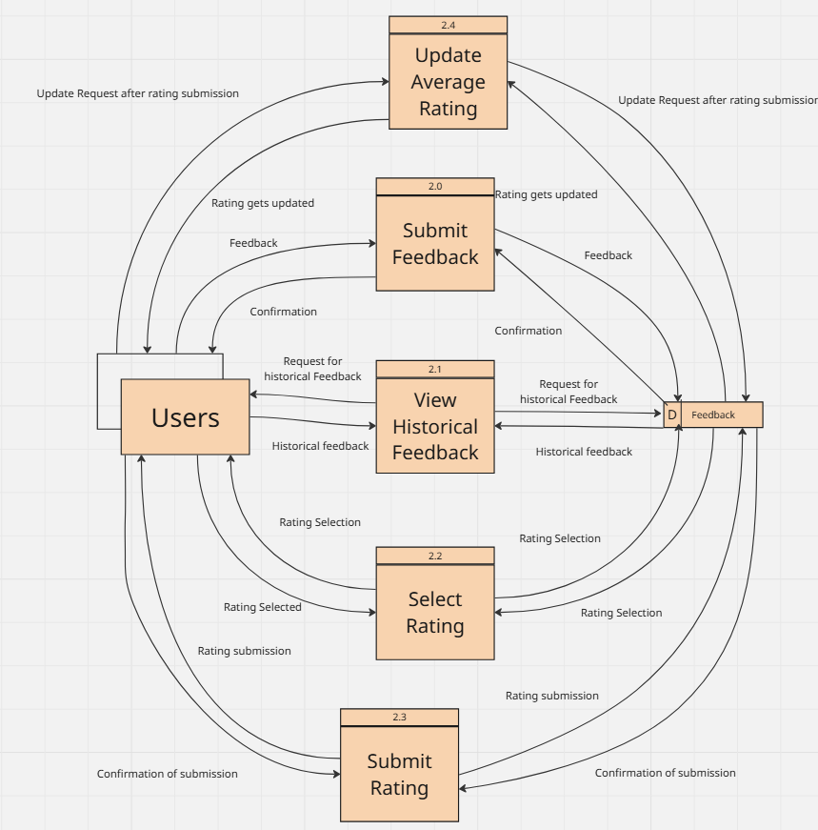
This level 0 dataflow diagram gives an overview on how data flows within the system, logging in, submitting feedback, making a booking and applying settings, all linking to different databases. This sort of overview allows for further exploration into each individual process as shown within the level 1 dataflow diagram.
This level 1 dataflow diagram shows more in specifics to the 2.0 submitting feedback process shown on the level 0 diagram. Allowing the user to select a rating, view historical feedback, submit feedback as well as update the average rating after their rating is submitted.

Slide 6
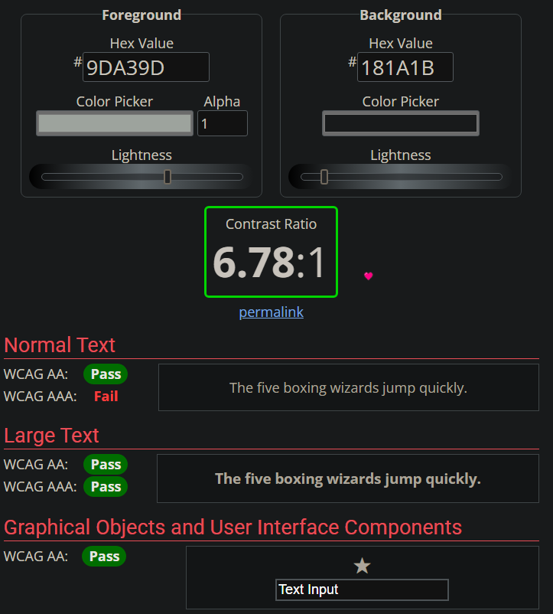
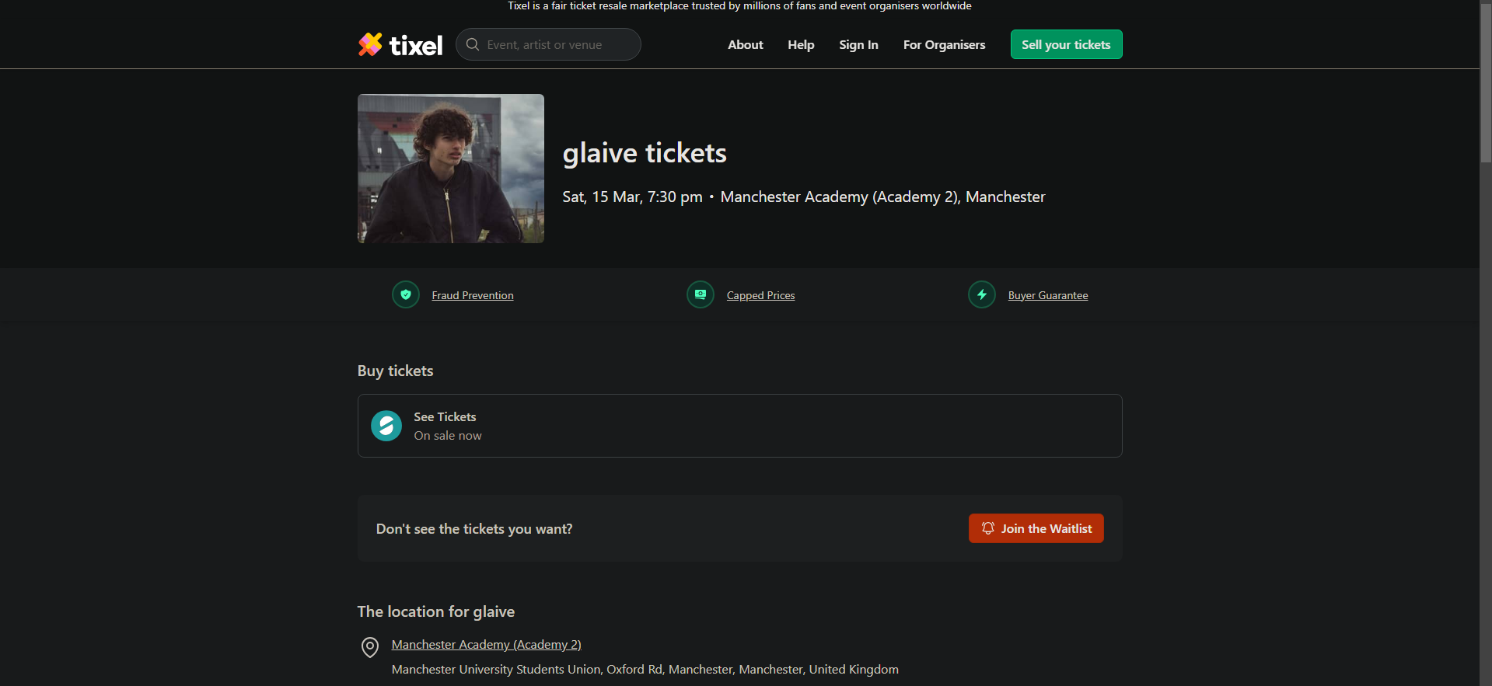
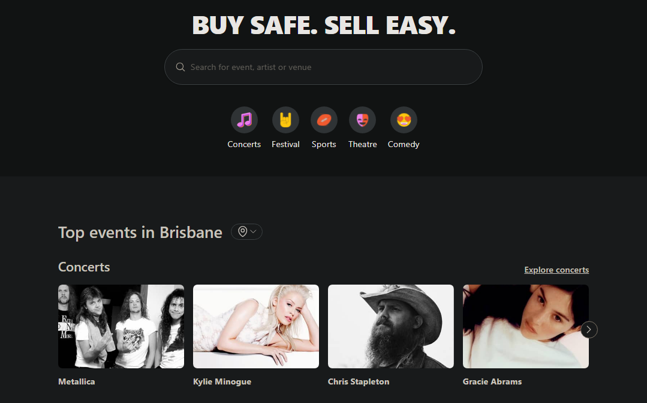
Existing solution (TIXEL.COM)
Accessibility: Colours contrast each other to all metrics but WCAG AAA normal text (Webaim, 2025)
Effectiveness and Utility: Information such as a date, time and venue are displayed and bookings available
Learnability: Key booking details are highlighted in a different colour
Effectiveness: Image to showcase the event
Safety: Trust formed via middleman service, fraud protection, guarantees and capped prices.
Learnability: User interface of search icon helps learnability
Effectiveness and Utility: Search bar to search for specific events
Learnability: Using graphics to display different type of events
Learnability, effectiveness and utility: UI icon that shows user they can change the location
Effectiveness: “Highlights” of popular events
Notes:
Consider also identifying user interface components so that you tick that box too.
It would be great if you were able to identify those components that impact the useability principles.
For example the icon usage in the search bar assists with learnability.

Slide 7
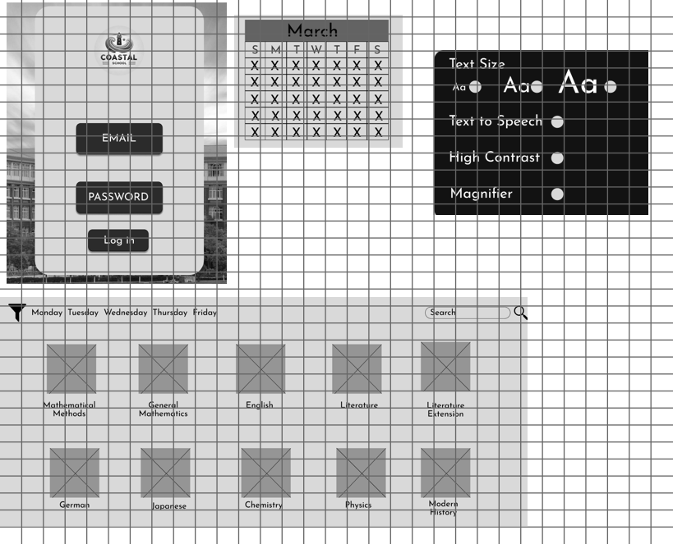

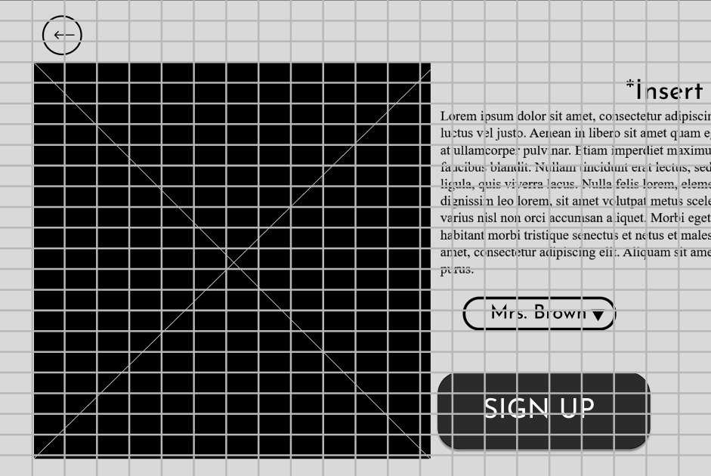
The wireframing sets out a base layout for the project. Providing a login page, calendar system, accessibility settings and a bookings page which show each subject and are able to be filtered by the days. The login page lets the user input their email and password as well as clicking the login button. This will verify against the database as to whether the user exists and if the password entered matches the password that the user has. The calendar allows to user to select when they want their booking from an already regularly used system. The accessibility settings include a setting to change the text size of the page, text to speech, high contrast and a magnifier. These settings particularly help those who are visually impaired or may have a low digital literacy. The bookings page allows users to select what subject they want to study. This is organized by a search feature as well as a filter to filter through what days the subjects are on, which is particularly helpful to students with a packed schedule who might only be available on Thursdays because they have training and games. Usability principles are present throughout the wireframes, accessibility is seen within the settings page, allowing users to enable many popular accessibility options. Learnability is shown through the icons used throughout, using icons like a funnel and search button indicate to the user what the respective areas do. Effectiveness and utility are shown throughout the login screen and calendar, creating an easy use for the user to sign in and pick dates for the study gym sessions. Safety is demonstrated in the signing up for bookings, where there is a safety feature for when signing up to see if they really wanted to and also an option to remove an already existing booking. All of these usability principles make for a website that can be easily navigable by the users.

Slide 8
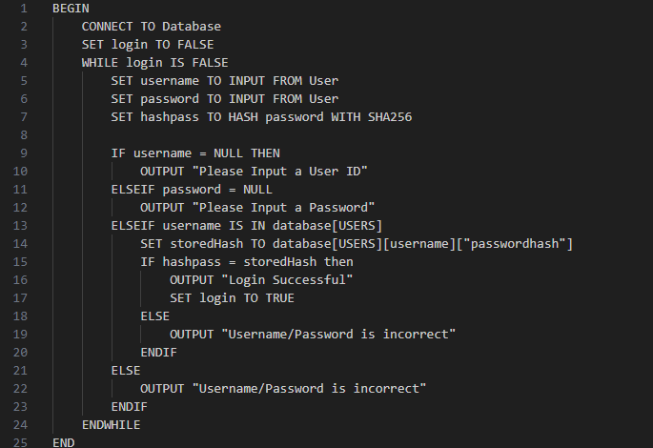
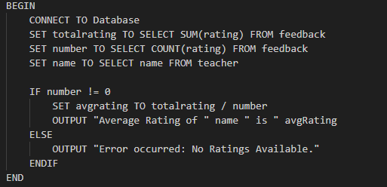
The pseudocode first connects to the database in order to grab critical information from said database, then sets the “status” of the login to false, meaning the user isn’t logged in. While the status is set to false, the user can input their username and password, this is set as the input from the user, the password is then hashed using SHA256. If the input areas are left empty, the user is prompted to insert something. The converted hashpass is tested against the database, with the user’s own hashpass, if they match then the user logs in. Otherwise, the error of the username/password being incorrect is outputted. And then since it is still within the while command, the user will be prompted to attempt to sign in again. AND SQL QUERIES LATER
The pseudocode first connects to the database available, grab critical information from said database. Grabbing the sum of ratings, number of ratings as well as the name of the teacher. The function IF number != 0 makes sure that the following code only occurs if the teacher has any reviews available. To create the average rating, the sum of ratings is divided by the number, outputting the average rating of the teacher and mentioning their name. If there aren’t any ratings available then that information is displayed
The first SQL query gathers the user’s ID, name, email, address and phone number, joining the Teacher_teaches table and subjects. And checking where the subject id is 4 (English) and where the role_id is 2 (teacher).
The second SQL query gathers the id of the session under the alias “Session_ID” for readability purposes, it also gets the time, date, attendance and saves the Teacher.name as Teacher_name and student.name as Student_name for readability/comprehension reasons. However, there is no student or teacher table, the way this is resolved is via aliases later on with both “JOIN Users” queries. Both of these queriers not only create the alias of teacher.id and student.id meaning the teacher.name and student.name can be obtained from the users table but also checking that the teacher.role_id is 2 (ergo a teacher) and that the student.role_id is 1 (ergo a student). The query also specifically searches for sessions on the 25/03/2025 and for the subject id 4 (where the subject is English (tutorialspoint, 2025).
SELECT Users.id, Users.name, Users.email, Users.address, Users.number
FROM Users
JOIN Teacher_teaches ON Users.id = Teacher_teaches.Users_id
JOIN Subjects ON Teacher_teaches.Subjects_id = Subjects.id
WHERE Subjects.id = 4 AND Users.role_id = 2;
SELECT Sessions.id AS Session_ID, Sessions.Time, Sessions.Date, Sessions.Attendance, Teacher.name AS Teacher_Name, Student.name AS Student_Name FROM Sessions
JOIN Subjects ON Sessions.Subject_id = Subjects.id
JOIN Teacher_teaches ON Teacher_teaches.Subjects_id = Sessions.Subject_id
JOIN Users AS Teacher ON Teacher_teaches.Users_id = Teacher.id AND Teacher.role_id = 2
JOIN Bookings ON Sessions.id = Bookings.session_id
JOIN Users AS Student ON Bookings.Users_id = Student.id AND Student.role_id = 1
WHERE Sessions.Date = '20250325' AND Subjects.id = 4;

Slide 9
Evaluation
Personal | Social | Economical | Legal
The program will improve student’s devotion to study as it provides an interactive workspace that students can seek help for topics they may not understand or not fully grasp the concept of. With accessibility, useability and digital copyright criteria being met. | Such a tool can help improve the whole entire school’s academics and passion for studying, not just the students that participate in the Study Gym program. It also helps students connect as sometimes they may feel shy to ask for help. Such a platform will encourage students to reach out to each other for help in more than just academics | This platform is such a small investment for what could be a massive return and improvement on academics, getting designated teachers to stay behind and help students would not cost the school a significant amount, | All data used to open data and publicly available (GitHub, 2025). All copyright was followed in accordance with CC 4.0 and APA 7 referencing used for relevant resources.
The prescribed criteria is hit at all metrics. The secure platform developed does allow for a streamlined tutoring process for The Coastal School to help students. Teachers are able utilise management services and a tracking system is in place to assist students in tracking their progress throughout the sessions. Comprehensive reports for the admin staff are provided, allowing them to properly assess how this platform can improve productivity and results. With an accessible user interface as well as accessibility students to help those with low tech literacy, with a feedback being implemented for all parties to help lift each party up on their weaknesses. However, due to the constraint of time, as the task was within a 6 week timeframe, the journal for personal growth tracking as well as reflections were not able to be implemented. It is suggested that this is added if the Study Gym concept is taken further. This would assist students with their academics, as it is been proven before that academic journals improves academics performance (University of Saint Augustine for Health Sciences, 2020).
Recommendations
It is recommended that the database is modified to include more variables, or to better constrain the flow of data. It is further recommended that if the project is continued, an automated system is utilised. The implementation of a journal to help track academic progress is also an addition that should take place, due to the research proving that journaling and keeping records of academics improves them. Overall, the program is well built and meets almost all of the criteria. It should just be optimised and improved via extra UI elements and a more modern/sleek look if it gets published and used by the school. As it needs to maintain its professional stance.
Notes:
PHP myadmin doesn’t necessarily need manual inputs I’m confused what you mean here.

Slide 10
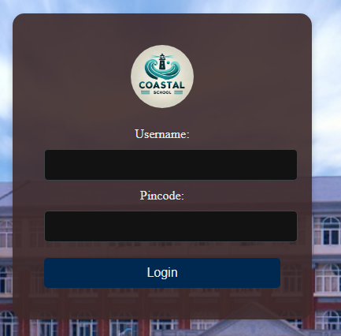
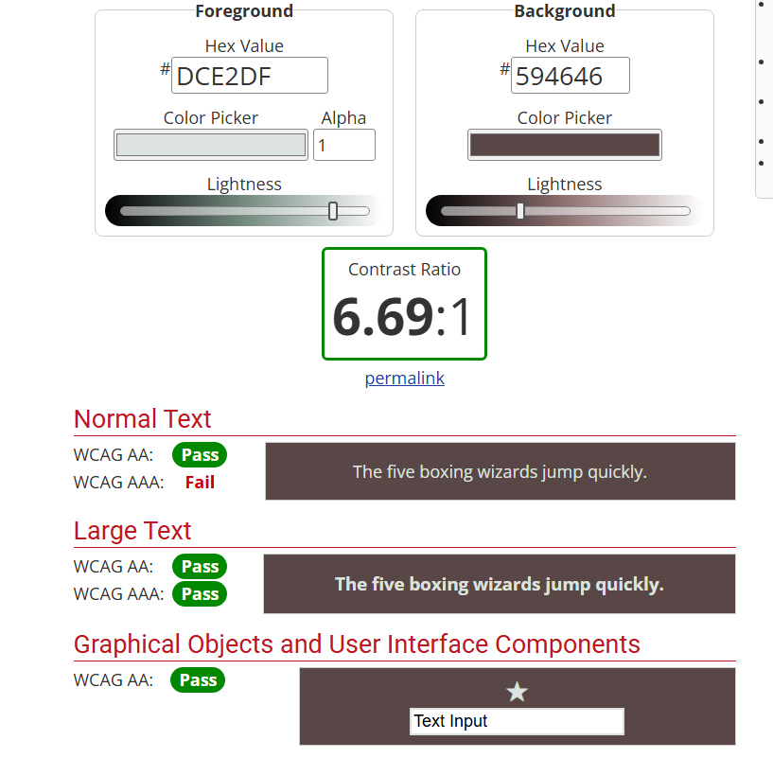
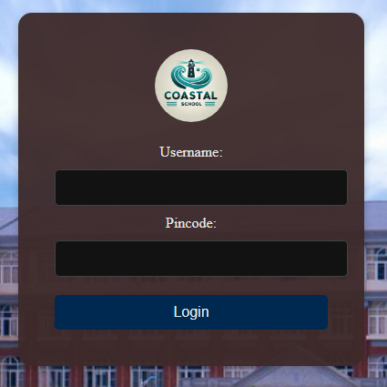
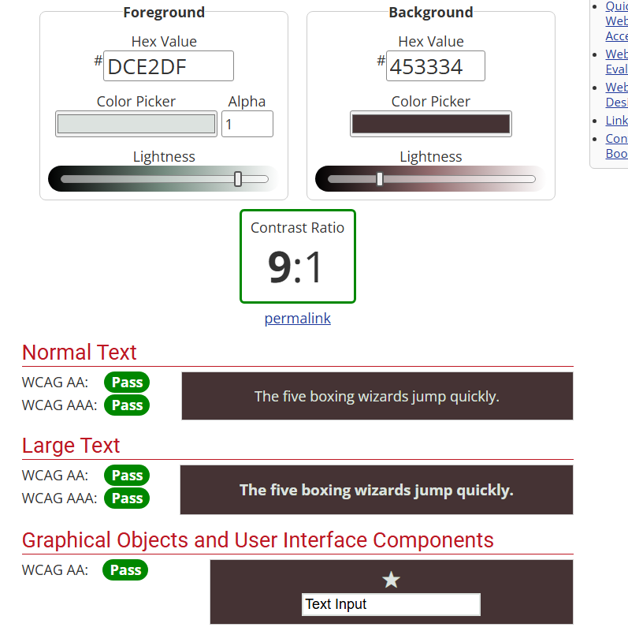
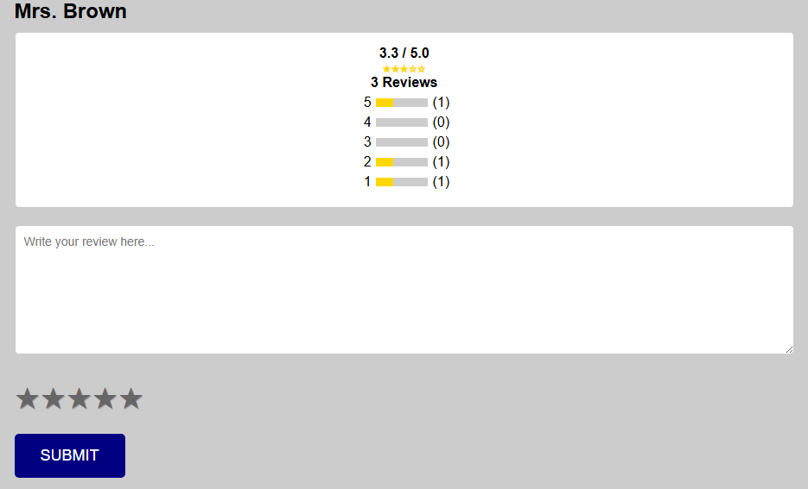
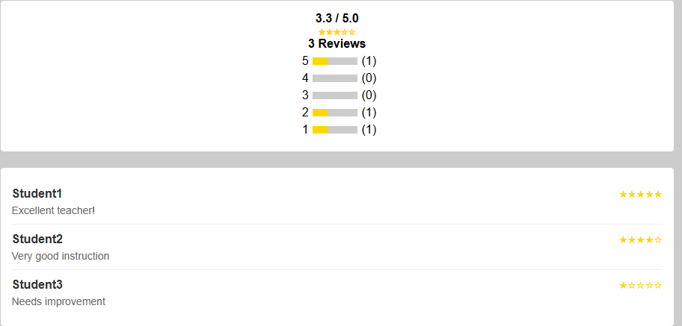
Refinements
Out of 37 colour-blind students surveyed, 28 of them found the white text hard to read in the maroon background in order to help these students this is evidenced by the original design failing the WCAG AAA, an indicator of colour contrast and readability, the colour was slightly modified to a lighter shade by increasing the opacity of the maroon login box. This helps with accessibility, one of the usability principles (Webaim, 2025).
96% of users surveyed wanted to be able to see the current feedback on the teacher, as well as the student’s name that gave the feedback in order to gauge the teacher. This simple function will help students make a decision on whether or not to choose that teacher. Adding this feature improves with utility and effectiveness, allowing to user to do what they want to and the system being utilised in a manner that improves user experience.

Slide 11
Reference List
Geeks for Geeks (2025, Jan 9). Normal Forms in DBMS. Geeks for Geeks https://www.geeksforgeeks.org/normal-forms-in-dbms/
J3KYLL14. (2024, July 31). AssessmentData. Github. https://github.com/J3KYLL14/AssessmentData/commits/main/Study_Gym_Attendance.csv
Tixel. (2025, March 10). Glaive Tickets. Tixel. https://tixel.com/au/music-tickets/glaive
Tutorialspoint. (2025, March 21). ALIAS Syntax. Tutorialspoint. https://www.tutorialspoint.com/sqlite/sqlite_alias_syntax.htm
University of Saint Augustine for Health Sciences. (2020, December 30). 10 Ways Journaling Benefits Students. University of Saint Augustine for Health Sciences. https://www.usa.edu/blog/ways-journaling-benefits-students/
Webaim. (2025, March 10). Contrast Checker. Webaim. https://webaim.org/resources/contrastchecker/

